Slide 1
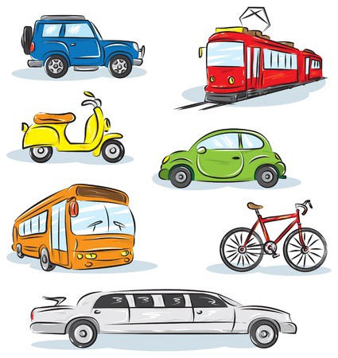
Name: ______________ ______________ ______________ ______________
Weekly Challenge
Teaching a student to become a success happens both in the classroom and at home. You are encouraged to complete the weekly challenge with your child by next Thursday, April 16th.
Academics!
Read Each Night!
Transportation Pattern Practice
What did you read this week?
Thursday 4/9: ___________________________
Friday 4/10: __________________ ______________ __
Saturday 4/11: _________________ ______________
Sunday 4/12: _________________________________
Monday 4/13: ____________________________ _____
Tuesday 4/14: ________________________________
Wednesday 4/15:____________________________ _____________ ________
Let’s Learn Through Play!
Family Game Night!
Who did you play with? _____________________________
What game did you play? ____________________________
Letter - Show & Tell!
Please share something transportation related on Thursday 4/16.
Once completed, your child will be entered into a weekly drawing for a FREE book! ☺ Happy Learning!
© Melissa Finch 2015

